Slide 1
MSDS 6306 Case Study 1
David Shaw

Slide 2
Introduction
Purpose: analyze high-level statistics about your company’s supply chain and the product produced
Questions of interest:
Distribution of manufacturing centers
Alcohol and bitterness content of beers in production
Relationship between ABV and IBU
Notes:
Purpose: …. give insight about the supply side of your company, will not do analysis of demand side – sales, marketing, etc.

Slide 3
Breweries by State
Most breweries located in California and Colorado
At least one in every single state, including DC
Potential growth opportunity in under-represented states
Notes:
- Mention TN, NJ, GA as potential candidates for expansion – in upper half of US states by population, but underrepresented here

Slide 4
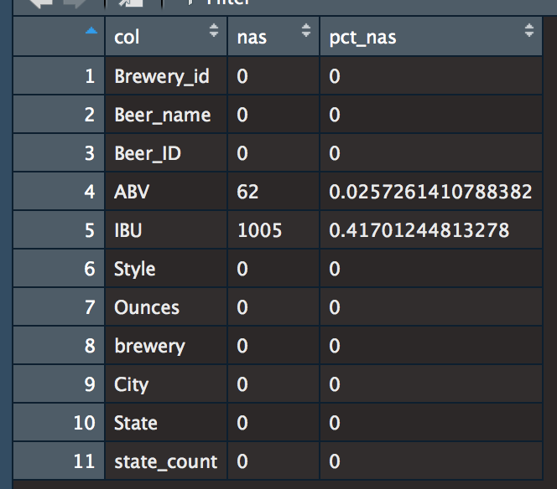
Missing Value Handling
Missing information about product
Decisions about dropping, imputing, or predicting missing values
Choices: prediction, imputation, dropping
Eventual choice: mean imputation, by state
Notes:
Number of ways to handle missing data
- Ideal is a logical value to impute, i.e. 0
– Next best is using a robust linear regression to predict missing values based on other variables in the dataset
- Then imputation using mean or median, at the most granular level possible
- Worst case is dropping missing terms

Slide 5
Alcohol and Bitterness Measures by State
Notes:
Top 3 in ABV: Kentucky, Colorado, Michigan
Top 3 in IBU: West Virginia, New Mexico, DC
Done after imputation in step above

Slide 6
Relationship Between Bitterness and Alcohol
No significant outliers were detected
Seemingly strong relationship
Simple linear regression unlikely to be robust
Notes:
-Constant variance violated
- Could perform lin reg with transformation, but beyond scope of this presentation

Slide 7
Conclusion
Brewery count by State:
Most – CA, CO, MI
Least – DC, ND, SD, WV
Alcohol and Bitterness by State
ABV
Most – KY, CO, MI
Least – WY, NJ, UT
IBU
Most – WV, NM, DC
Least - IA, WI, KS
Possible linear relationship between ABV and IBU

